Slide 1
Avaya IP Office Contact Center
NOTE TO AVAYA SALES & PARTNERS
THIS PRESENTATION FOCUSES ON IP OFFICE CONTACT CENTER DELIVERED ON-PREMISE
For Customer Engagement OnAvaya Powered by Google Cloud Platform resources please visit https://sales.avaya.com/en/general/customer-engagement-onavaya?view=collateral
Yellow boxes and notes pages provide instructions for use – please remove them before delivering to a customer
Customize this presentation before using it with customers to ensure the content addresses their specific requirements
Update date and presenter information on this slide
Be sure to reference the Notes for talking points and details. We tried to keep the slides as uncluttered as possible.
Customer Presentation
IP Office Contact Center Customer Presentation 27 April 2015
Notes:
This presentation covers the new midmarket contact center solution for IP Office – Avaya IP Office Contact Center.

Slide 2
Avaya Midmarket Collaboration Solution Simple, Powerful & Affordable
Customer Engagement
Team Engagement
Networking
Security
Notes:
The Avaya IP Office suite of solutions is a comprehensive suite of customer engagement solutions right-sized for small and midsized businesses. Depending on your business needs, you get choice of on-premise IP Office Contact Center or hosted IP Office Contact Center via Customer Engagement OnAvaya Powered by the Google Cloud Platform. In this presentation, we focus on the on-premise IP Office Contact Center.
IP Office is the flagship solution for Small and midsize business scaling to 3000 users across up to 150 nodes. UC and mobility are fundamental, and almost table stakes for any midmarket business, and are delivered as core, included functionality.
Driving your success is a full collaboration suite, fully integrated to IP Office, delivered by a single vendor – Avaya.
When considering new IP solutions, you need to consider infrastructure to support higher bandwidth with VoIP, Power over Ethernet to support IP phones, and of course video. Avaya provides a broad range of Ethernet solutions to suit needs and budget.
Security is top of mind for all business, securing SIP trunks and remote workers is the work of the Avaya Session Border Controllers, that also provides identity engines allowing your staff to bring their personal devices to the work place
Providing you with solutions from a single vendor reduces complexity, and integration risk.

Slide 3
The Evolution of Customer Engagement
23%
59%
INTERNET SELF-SERVICE
WEB CHAT
73%
Millennials will stop doing business with a company after one bad experience2
20%
TWITTER, FACEBOOK
82%
BUY MORE from companies that make it easy to do business1
77%
PHONE
64%
STORE
50%
say they constantly change how they deal with organizations
9 of 10
9 of 10 consumers want support while online
% using channel to communicate with organizations
Notes:
Customer service is vital to a business survival, add to that the evolution of Customer experience, and the different ways they can, and want to do business with you. A phone call is good, but your customers are seeking other channels to conduct business with you
When customers need to contact a company, they increasingly prefer website portals, email, chat sessions, and even social media rather than voice. Integrating all of these options helps ensure that a business can address their issues using the channel they prefer and in the timeframe they expect. This is key to enhancing customer loyalty.
As can be seen by the figures, todays millenials don’t have patience for bad service, supporting the channels your customers are now demanding is the way forward

Slide 4
Contact Center Priorities
What is your single, most important contact center need?
52% Inbound Customer Service
31% Inbound Sales
15% Outbound Sales
Tech Buyer Perceptions, Avaya Midmarket Technology Study, February 2014
Notes:
In a recent Avaya, contact center users were asked what the single most important need they have:
Inbound service came out top -
Attracting customers is a top priority for any company, but retaining those customers over the long term is even more critical. It is well known that it costs five to six times as much to get a new customer as it does to keep one, so keeping existing customers happy should be a primary goal for any business.
Inbound sales
E-commerce has the built-in advantage of convenience, but online shoppers still want a personalized experience. How to support it:
Outbound sales
Outbound campaigns targeting existing customers or new prospects are opportunities to engage customers proactively and make full use of agents' "quiet times’

Slide 5
Contact Center Challenges
Challenges
Resolution
Customers are wanting to communicate on their terms
Customers often need to repeat themselves once answered
Customers are reporting bad service with agents
Agents are not productive during quiet times
Losing sales as callers are dropping before we answer
Incorporate email and web chat as part of the contact center strategy
Eliminate/reduce transfers
Detailed call reports and call recordings on every agent
Use agent ‘idle time’ to proactively make outbound sales/collection calls
Identify peaks and balance agents between groups
IVR to offer self service
Notes:
Every contact center has challenges, and we have picked out just some.
Your customers want to communicate, and conduct business with you on their terms, and that extends beyond a simple phone call. Incorporating other channels into your contact center ensures you are meeting those demands, in a timely fashion.
The worst experience you can give to a customer is transferring them around the business, and each time having to repeat information! You need to employ technology that will eliminate transfers, and if you do need to transfer, making sure the customers information is taken with that call
Its difficult to deal with:
“I had to wait a long time to be answered”
“Spent way too long on hold”
“The agent was rude”
You need to be able to accurately measure and get statistics so adjustments can be made with staffing and routing of calls. Measuring agent performance and recording calls, enables you manage agent to customer performance
Agents of course are always busy, however, during the quiet times what are agents doing? You could use this ‘slack’ time to increaser revenue with agents making outbound calls – automatically
At peak times, its all too easy for customers to give-up and call later – or worse, call a competitor. During peak times, if agents are not available, you provide alternatives to keep the customer holding, leave a message for call back, or complete an agent less transaction

Slide 6
Avaya IP Office Contact Center Overview
Customers with up to 3000* employees & up to 250 agents
Deployed as a single site or across up to 150 nodes
Agents in the office or remote agents
Centrally managed
Available on-premise or hosted via Customer Engagement OnAvayaTM Powered by Google Cloud Platform
*Select Edition supports up to 3000 users
Notes:
We’ll show you how, with IP Office Contact Center, these challenges can be resolved. IP Office contact center is targeted for customers with up to 3000 employees and between 5 to 250 agents.
This solution is at home at a single office or across the connected IP Office enterprise, spreading agents to allow longer operating hours for your customers. Being flexible by employing home agents, maximizes talent attainment and improves agent morale and reduces turnover, which as you know, agents are the highest expense in a contact center. The solution is a single server at one location, meaning your IT staff can centrally manage the entire IP Office system and the contact center. Supervisors can make changes on the fly no matter where the agents are located.

Slide 7
Avaya IP Office Contact Center Capabilities
Resolution with Avaya IP Office Contact Center
Multichannel
include email, web chat and voice
Skills based routing
Eliminate transfers
Call recording/Call reports
Eliminate conflicts, improve agent/customer interactions, measure agent performance
Outbound dialing
Use agent ‘down time’ to automatically make outbound calls
Real time reports
Monitor wait times - move agents between groups ‘on the fly’
IVR
Offer self service to free up agent time
Notes:
Your customers demand flexibility - the multichannel Avaya IP Office Contact Center supports voice, email, and Web chat channels for optimal accessibility
Skills based routing makes sure your customers and prospects are routed to the most appropriate agent or resource
Supervisors have complete visibility and control of the contact center with Call Reporting and recording — comprehensive reports can highlight the good – and not so good, so you can adjust according to season, time of day etc
Outbound dialing – improve sales revenue, upsell opportunities and optimize agent productivity, by automatically make outbound calls to existing customer or new prospects
Real time reports give up to the second information on what is happening now. Supervisors can react quickly, such as moving agents between groups, logging agents on who have been ‘wrap-up’ for too long, even change the call routing. Each agent also has a ‘wallboard; so they can see calls waiting, how long, answered and receive other text messages from the supervisor
IVR : Self-service solutions are packaged with the included IVR—giving agents more time to deal with live voice calls and reducing wait times.

Slide 8
What’s New with IP Office Contact Center
Availability as thin client enables organizations to be up and running faster
OPEX deployments via Customer Engagement OnAvayaTM Powered by Google Cloud Platform*
Support for WebRTC softphones
* Customer Engagement OnAvayaTM Powered by Google Cloud Platform deployments available in US and English only
Notes:
IP Office 9.1.2 FP Generally Available as of Aug 3, 2015
Now customers can take advantage of enhanced flexibility with availability as a thin client. Browser-based and OPEX deployments are available through Customer Engagement OnAvaya Powered by Google Cloud Platform through which companies can enable agents and supervisors to work from home or remotely via a browser-based contact center application.

Slide 9
IP Office Contact Center & Customer Engagement OnAvaya Powered by Google Cloud Platform Comparison Overview
 | IP Office Contact Center (On-Premise) | Customer Engagement OnAvaya Powered by Google Cloud Platform
Delivery model | On-premise IP Office Contact Center on IP Office | Avaya branded and hosted IP Office & IP Office Contact Center, delivered on Google Cloud Platform
Client | Thick Windows client for PC & Thin Chrome Client for Chrome devices | Thin Chrome client on Chrome devices
User Interface | UI for IP Office Contact Center has not changed. UI for thin Chrome client built specifically for Chrome OS | UI built specifically for Chrome OS
Agent Capacity (min to max) | 5-250 agents | 10-250 agents
Capabilities | Voice, Multichannel, Skills-based Routing, Call Recording, Real-time & Historical Reporting, Outbound Dialing, IVR | Voice (Multichannel roadmapped), Skills-based Routing, Call Recording, Real-time & Historical Reporting, Outbound Dialing, IVR
Endpoints | Avaya 96xx/16xx/14xx/95xx Phones, Headsets, Windows Communicator 2.0.3+ | Avaya IP 96x1 IP Phones, Headsets, Support for WebRTC softphone
Availability & Localization | Global English only | US only English only
Notes:
Chart that outlines capacity and capability comparisons between IPOCC (CPE deployment) and Customer Engagement OnAvaya.

Slide 10
Avaya IP Office
Multichannel Contact Center
Customers and Prospect
Contact Center Resources
Agent Groups
Voice
Universal Queue
Media-specific
Skills-based routing
Agent
Email
External Destination
Web Chat
Waiting Announcements
IVR
Outbound
Dialer
Notes:
Think of IP Office Contact Center as the glue between your customers and your business, taking the different channels – Voice, Email web chat, and organizing, prioritizing and routing them to a resource.
That resource can be an agent, IVR, message and so on.
Traditionally emails may end up at an individuals inbox, or a group box, and may not get answered for hours, if not days. Now they can put in ‘queue’ and answered in the priority you determine. Agents can handle all 3 channels simultaneously

Slide 11
Solving Business Challenges with a
Multichannel Contact Center
Inbound Calls | Outbound Calling | Email | Chat
Route callers to most able agent Optimize agent skills Prioritize callers | Collections Appointment and late payment reminders Special offers | Offload non-critical inquiries to email Keyword routing Auto responses | Push urls Assist with online shopping Product and services support
Boost Customer Experience and Satisfaction
Improve Agent Occupancy and Increase Revenues
Provide Fast Responses to Email Inquiries
Increase Sales/Support Efficiency

Slide 12
Skills Based Routing
Reduce or eliminate transfers
Delivers optimum customer experience to your customers
Set your agent skill levels based on:
Product expertise
Spoken languages
Availability
History
Unlimited skills
System
Per agent
Assign % skill level
Topic
Per agent
Best agent to handle call
Routing based on:
Dialed Number
IVR
Calling number
Auto attendant
Backup agent to handle call
Backup agents or alternative
Notes:
Enhanced customer experience: Skills-based routing enables the system to intelligently route customer inquiries to the most appropriate agent or service based on knowledge, language, availability, communication channel,, and even past experience. Routing a call to the expert, handling calls in the language of the caller, placing regular customers to the agent who has dealt with them before, increases customer satisfaction, reduced wait times, eliminating excessive transfers, and minimizing customer frustration.
IP Office Contact center employs almost limitless possibilities with skills and skill levels

Slide 13
Call Recording
Eliminate conflicts - the ‘he said, she said’ syndrome
Monitor and improve agent to customer interaction
Record
Every agent call
Random selection
‘Now’ with the press of a button
Quickly and easily search and replay
Agent number
Called/Calling number
Date, time etc
Notes:
Call recording is fact of life for most contact centers, serving several important roles:
Elimination of conflicts, i.e “I told you to pick me up at 3pm from JFK – where were you” with a quick search using the intuitive GUI, the supervisor can search by agent, dialed number, time of day etc, and find the recorded call, by doing so you can quickly determine the breakdown.”
Using good calls as a benchmark for training other and new agents.
Every call can be recorded, or a random selection, during the day. The agent can also press a button for emergency situations. During the recording the agent can pause recordings so confidential customer information is not recorded
Every agent voice license also includes a preferred edition port for call recording purposes, making it extremely cost effective.

Slide 14
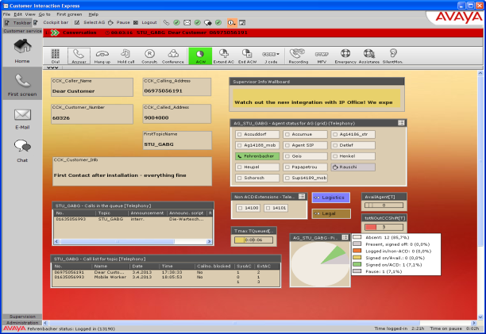
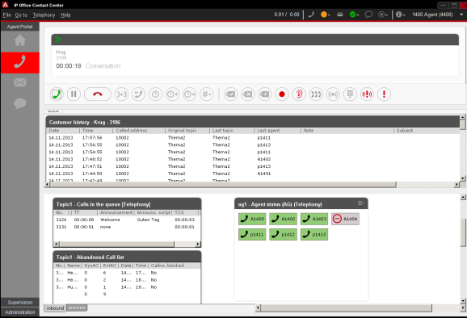
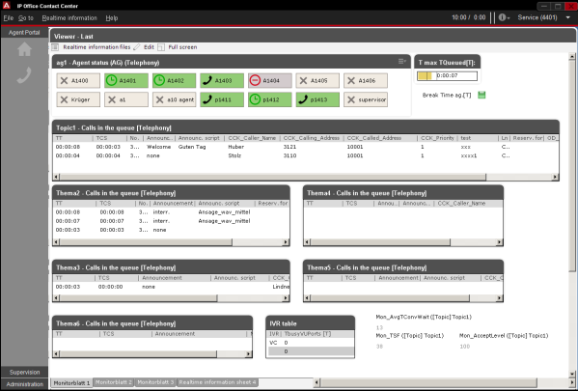
Call Reporting
Customizable real time and historical reports
Scheduled, instantaneous
Threshold alarms
Calls waiting, lost calls
Powerful, customizable agent desktop
Multichannel view – voice, email web chat
Telephony control
Works with almost any phone
Notes:
Of course reports are crucial for any contact center. They enable supervisors to adjust for seasons, promotions and campaigns, and adjust (agents, routing etc) to achieve optimal customer service. Reports can be scheduled to print to pdf, excel, csv and so on, so reports are waiting at the beginning of the day.
Real time reports on the supervisors screen keep them up to date on performance ‘now’ – are they meeting SLA’s are calls waiting too long – do I need to move agents between groups.
The customizable windows agent desktop includes simple-to-use features designed to speed multichannel transactions and keep agents fully informed. Agents can log-in to any or all of the voice calling groups to which they are assigned, and to select email groups and if they will be answering web-chat, and which ones. A skilled agent can handle all 3 simultaneously, and traverse quickly and seamlessly across them

Slide 15
Outbound Dialing
Increase sales revenue
Advertising campaigns
Upsell opportunities, post sale
Improved agent efficiency
Automatically start outbound tasks on decreased workload
Reduce/eliminate misdials
Better prepared agents
‘Preview’ customer information before placing call
Notes:
Sometimes, agents can be ‘free’ – what do they do? One way to make them productive is to initiate outbound calls when the inbound activity is perhaps drying up. When a certain criteria is met, agents can automatically start to make outbound calls to current customers or new prospects.
Pre-defined scripts make sure agents are prepared, and customer information is presented on screen,
Outbound dialing is a great resource to upsell (post sale warranty, accessories) and to increase revenue, while maximizing agent productivity

Slide 16
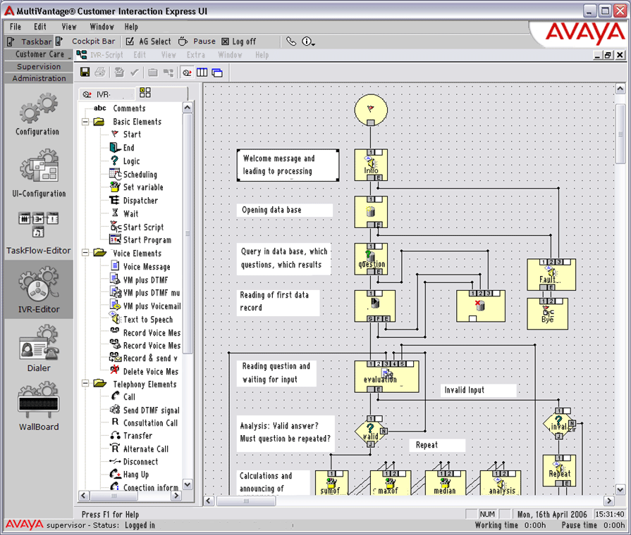
Self Service
Provide customer self service anytime - anywhere
Reduce agent ‘live’ time, free up for important voice calls
Integrate to ODBC database for information playback
Provide comprehensive self service
Add speech recognition and text to speech as an option
99 simultaneous sessions
Intuitive Graphical Script editor
Fast creation and editing
Notes:
Another element of daily life is IVR or Interactive Voice Response, banks, airlines etc all use IVR to conduct all or part of a transaction. IP Office Contact Center can integrate to most databases, providing feedback to customers without the need for an agent. letting customers self serve frees agents to attend to live voice calls, live voice calls are of course a priority.

Slide 17
Gartner Magic Quadrant for Contact Center Infrastructure
Magic Quadrant for
Contact Center Infrastructure Worldwide
Drew Kraus, Steve Blood, Sorell Slaymaker
May 18, 2015
Full report is available at
http://www.gartner.com/reprints/avaya-v11?id=1-2GHA3WB&ct=150527&st=sb
This graphic was published by Gartner, Inc. as part of a larger research document and should be evaluated in the context of the entire document. The Gartner document is available upon request from Avaya.
Gartner does not endorse any vendor, product or service depicted in its research publications, and does not advise technology users to select only those vendors with the highest ratings or other designation. Gartner research publications consist of the opinions of Gartner's research organization and should not be construed as statements of fact. Gartner disclaims all warranties, expressed or implied, with respect to this research, including any warranties of merchantability or fitness for a particular purpose.

Slide 18
Avaya Midmarket Collaboration Solution Simple, Powerful & Affordable
Contact Center
Collaboration
Multichannel
Skills based routing
Call recording and reporting
Room, desktop, mobile
Supports 3rd party devices
Simple, affordable
Broadest endpoint support
Most flexible deployments
Rich UC feature set
Unified Communications
Conference control
User presence
WiFi/3G/4G connectivity
Mobility
Security
Networking
Helps protect SIP
trunks
Increases remote endpoint security
Active packet inspection
Automated provisioning
Rich feature set
50% lower TCO
Notes:
IP Office is powerful collaboration platform supporting rich UC, broad range of endpoints – IP, digital, analog and SIP and flexible mobility solutions for android devices – tablets and phones, and iPhone/iPad. Surrounding the core platform, collaboration solutions bring powerful Video and Audio conferencing solutions to the business, connecting staff and customers.
The Avaya networking solutions is the infrastructure to support video, ip phones etc it is vital to provide QoS and PoE enabling seamless, high quality video and voice with a proven low total cost of ownership (tolly report)
With the popularity of remote workers, SIP trunks, and employees bringing their own devices to the workplace (BYOD) securing them is crucial. The Avaya Session Border Controllers is your one solution to secure all devices
And as you have just seen Contact Center completes the picture.
Net net – Avaya is your single vendor for simple, powerful, complete and affordable collaboration

